Slide 1
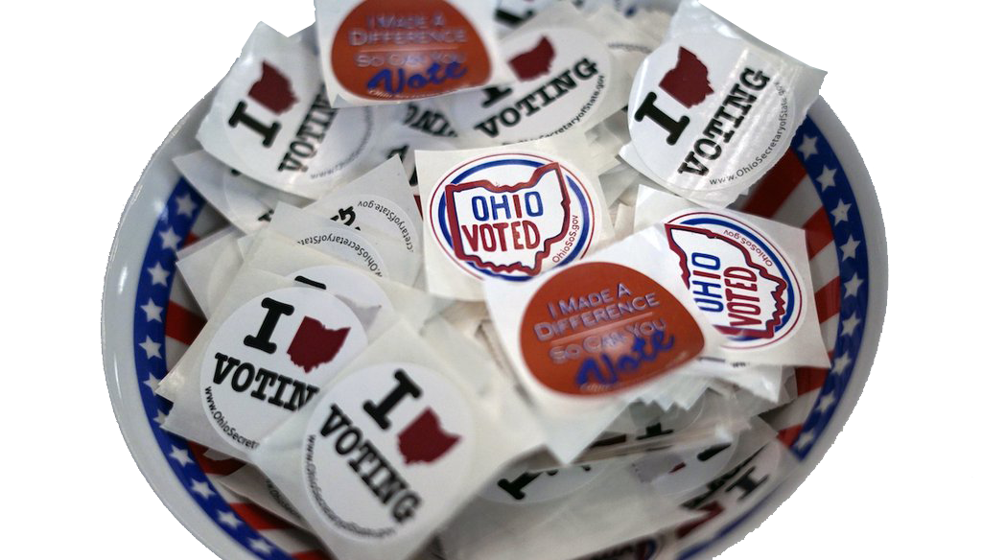
November 2023
Ballot Issues
Hamilton County, Ohio
Notes:
Quick into on the League

Slide 2
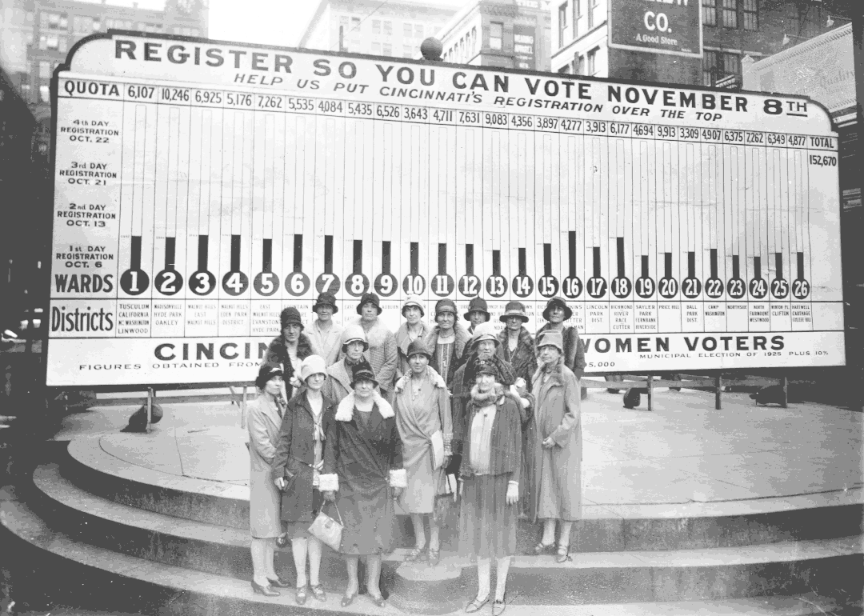
League of Women Voters in Cincinnati
The LWVCA is a nonpartisan political organization encouraging informed and active participation in government
Never favors a candidate/party, may take positions on issues
Our work: public policy initiatives, education and advocacy for voter rights, providing various voter services, speaker forums on community issues, and more
Notes:
The League of Women Voters of the Cincinnati Area is a nonpartisan political organization encouraging informed and active participation in government with membership open to anyone, male or female, 16 years of age or older.

Slide 3
2023 Ballot Issues
Statewide Issues
1. Reproductive Rights/Abortion
2. Recreational Marijuana
Hamilton County Issues
19. Zoo Levy
20. Library Levy
Cincinnati Issues
22. Sale of Railroad
23. Miscellaneous Charter Changes
24. Financing Affordable Housing
Lots of local municipal and township levies, amendments, etc.

Slide 4
Issue 1 – Reproductive Rights/Abortion
Ohio constitutional amendment placed on ballot by citizen petition.
Text of amendment:
Every individual has a right to make and carry out one’s own reproductive decisions, including but not limited to decisions on:
contraception;
fertility treatment;
continuing one’s own pregnancy;
miscarriage care;
and abortion.
continued

Slide 5
Issue 1 – Reproductive Rights continued
The State shall not, directly or indirectly, burden, penalize, prohibit, interfere with, or discriminate against either:
An individual’s voluntary exercise of this right or
A person or entity that assists an individual exercising this right, unless the State demonstrates that it is using the least restrictive means to advance the individual’s health in accordance with widely accepted and evidence-based standards of care.
However, abortion may be prohibited after fetal viability. But in no case may such an abortion be prohibited if in the professional judgment of the pregnant patient’s treating physician it is necessary to protect the pregnant patient’s life or health.

Slide 6
Issue 2 – Recreational Marijuana
An initiated statute, put on the ballot by citizen petition. As a statute, it can be repealed or amended by the state legislature.
The Coalition to Regulate Marijuana Like Alcohol sponsored the initiative.
If voters approve the initiative, Ohio would become the 24th state to legalize marijuana for recreational and personal use.
Ohio voters legalized medical marijuana in 2016.

Slide 7
Issue 2 – Recreational Marijuana
Legalizes marijuana for adults 21 years old and older, allowing adults to possess up to 2.5 ounces of marijuana and grow up to six mature marijuana plants and up to six seedlings, and enacting a 10% tax on marijuana sales.
The Division of Cannabis Control, created under the initiative, would be responsible for regulating and licensing marijuana operators and facilities and would oversee the compliance and standardization of marijuana businesses and production in Ohio.

Slide 8
Hamilton County Issue 19 - Zoo Levy
This proposed 5-year levy is a renewal of an existing 5-year levy that expires at the end of 2023.
Tax Levy Review Committee recommended an increase based on inflation since the last increase in 2008. However, the County Commission decided to put it on the ballot as a renewal with no increase.
The levy will cost property owners $9.01 for each $100,000 of the county auditor’s appraised value.
The Zoo is an amenity for local residents and an economic development driver because of its attraction of out-of-town visitors.

Slide 9
Hamilton County Issue 20 -Public Library Levy
10-year levy is a renewal with an increase. Last renewed in 2013.
Used for basic operating expenses at main downtown library and 40 branches throughout county. Library budget is 57% from the State and 43% from local taxes.
A separate levy passed in 2018 funds a major capital improvement program now underway.
Levy increase would add $18/yr per $100,000 home for a total of $74/yr for both library levies.

Slide 10
Cincinnati Issue 22 -Sale of Railroad
Since the 1800s, Cincinnati has owned a railroad line to Chattanooga. It is the only municipally owned, interstate rail line in the country.
It is leased to Norfolk Southern with annual payments of $25 million to the City.
Proposed sale to Norfolk Southern for $1.6 billion, with money going into a Trust Fund to pay for infrastructure needs of the City.

Slide 11
Issue 22 – Railroad Sale Pros
The revenue from the Trust Fund investments will be more than what the City is now receiving in annual lease payments. It is estimated the investments will earn about $50 million a year.
It will allow the City’s infrastructure to be modernized without raising taxes. There is a backlog of maintenance and infrastructure needs for roads, police & fire stations, parks, rec centers, etc.
The money will be in a Trust Fund invested and controlled by trustees and not under the direct control of city government.

Slide 12
Issue 22 – Railroad Sale Cons
The amount of the negotiated sale is too low.
Annual revenue from the Trust Fund is dependent on how well the investments do. It is safer for the City to continue to get the assured and stable annual lease payments.
Citizens can’t trust the politicians not to raid the Trust Fund for other purposes and use up the principal.

Slide 13
Cincinnnati Issue 23 Miscellaneous City Charter Changes
Placed on the ballot at the last minute by City Council. Proposed by Council Member Liz Keating.
Called a “cleanup” of the charter to mirror state law changes and add transparency.

Slide 14
Issue 23 Miscellaneous City Charter Changes
A copy of any citizen-led ballot petition must be filed with the Clerk of Council before any signatures can be collected.
Adds a cure period for ballot and candidate petitions, if deadline for filing has not passed.
Gives council permission to vote electronically.
Clarifies throughout the charter that council terms are two years.
Clarifies that candidate petition circulators must sign a statement rather than provide a notarized affidavit on candidate petitions.

Slide 15
Cincinnati Issue 24 – Funding Affordable Housing
Placed on the ballot by citizen petition
Second attempt. Different from the proposal that failed in 2021.
Raises the City Earnings Tax by 0.3% with the revenue dedicated to affordable housing.
The Fund will be managed by the City in consultation with a community advisory board.

Slide 16
Issue 24 - Affordable Housing Pros
Cincinnati is facing an affordable housing crisis. Rents and housing costs are rapidly increasing, more families are being priced out of the market and are facing homelessness.
Current City efforts are not enough and focus on middle income and market rate housing. We need a dedicated revenue stream to create truly affordable housing for all Cincinnati residents.
The earnings tax increase will bring it back to the 2020 level. Cincinnati’s earnings tax is lower than most Ohio large cities.

Slide 17
Issue 24 - Affordable Housing Cons
The tax increase is not needed because the City is already putting significant funding into affordable housing.
City funding priorities need to be flexible and not imbedded in the City Charter. Elected officials need to be able to adjust priorities and funding as needs change.
Voters were told the earnings tax would be reduced when they voted to move public transit funding to the County.

Slide 18
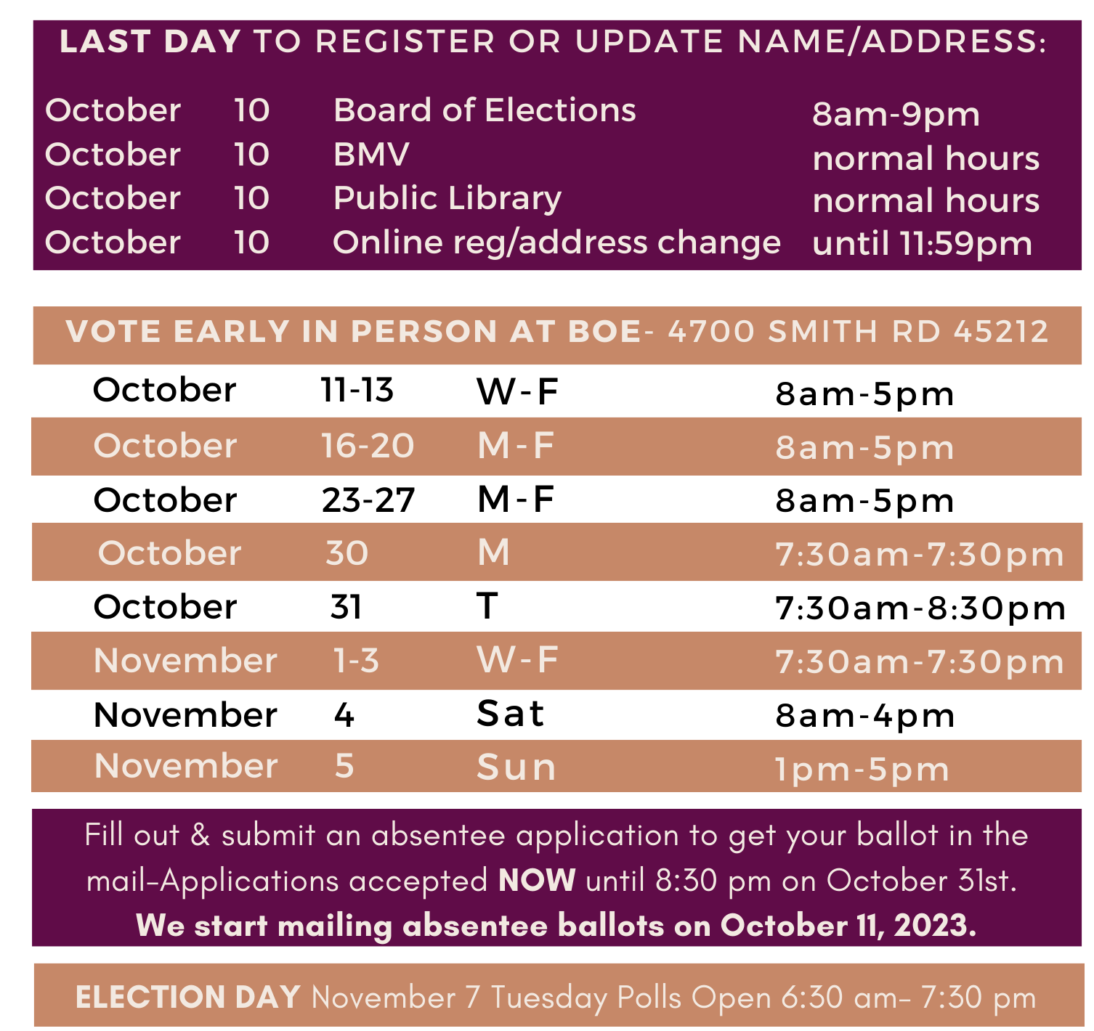
November 7, 2023 Election Timeline

Slide 19
New ID Requirements
Photo ID needed to vote in-person at Board of Elections or on Election Day
Mail-in Ballot only needs last digits of social security number
Address on ID does not need to match the voter’s registration address.

Slide 20
Be Prepared – Vote Informed
Find more detailed information on the ballot issues:
LWV Voter Guide available at libraries by October 11.
Vote411 is LWV online platform for ballot information.
Get a personalized sample ballot from Board of Elections website
https://votehamiltoncountyohio.gov
Select topic – “Find sample ballot”
Enter address

